Slide 1
Chapter 5
Competitive Rivalry and Competitive Dynamics

Slide 2
Definitions
Competitors:
  are firms operating in the same market, offering similar products, and targeting similar customers.
Competitive Rivalry:
  is the ongoing set of competitive actions and responses occurring between competitors.
  influences an individual firm’s ability to gain and sustain competitive advantages.

Slide 3
Definitions
Competitive Behavior
  The set of competitive actions and competitive responses the firm takes to build or defend its competitive advantages and to improve its market position.
Multimarket Competition
  Firms competing against each other in several product or geographic markets.
Competitive Dynamics
  The total set of actions and responses taken by all firms competing within a market.

Slide 4
From Competition to Competitive Dynamics
Competitors
Why?
To gain an advantageous market position
Engage
in
Competitive rivalry
Competitive behavior
  Competitive actions
  Competitive responses
How?
What Results?
What Results?
Competitive dynamics
Competitive actions and responses taken by all firms competing in a market

Slide 5
Competitive Rivalry’s Effect on Strategy
Success of a strategy is determined by:
  the firm’s initial competitive actions.
  how well it anticipates competitors’ responses to them.
  how well the firm anticipates and responds to its competitors’ initial actions.
Competitive rivalry:
  affects all types of strategies.
  has a dominant influence on the firm’s business-level strategy or strategies.

Slide 6
A Model of Competitive Rivalry
Firms are mutually interdependent when:
  a firm’s competitive actions have noticeable effects on its competitors.
  a firm’s competitive actions elicit competitive responses from its competitors.
  competitors feel each other’s actions and responses.
Marketplace success is a function of both individual strategies and the consequences of their use.

Slide 7
A Model of Competitive Rivalry
Competitive Analysis
Market commonality
Resource similarity
Drivers of Competitive Behavior
Awareness
Motivation
Ability
Feedback
Competitive Rivalry
Likelihood of attack
  First-mover benefits
  Organizational size
  Quality
Likelihood of response
  Type of competitive action
  Actor’s reputation
  Market dependence
Outcomes
Market position
Financial performance

Slide 8
Competitor Analysis
Competitor analysis is used to help a firm understand its competitors.
The firm studies competitors’ future objectives, current strategies, assumptions, and capabilities.
With the analysis, a firm is better able to predict competitors’ behaviors when forming its competitive actions and responses.

Slide 9
Market Commonality
Market commonality is concerned with the:
  number of markets with which a firm and a competitor are jointly involved.
  degree of importance of the individual markets to each competitor.
Firms competing against one another in several or many markets engage in multimarket competition.
  A firm with greater multimarket contact is less likely to initiate an attack, but more likely to more respond aggressively when attacked.

Slide 10
Resource Similarity
Resource similarity is:
  how comparable the firm’s tangible and intangible resources are to a competitor’s in terms of both types and amounts.
Firms with similar types and amounts of resources are likely to:
  have similar strengths and weaknesses.
  use similar strategies.
Assessing resource similarity is difficult if critical resources are intangible, rather than tangible.

Slide 11
Drivers of Competitive Behavior
Awareness
Awareness is:
  the extent to which competitors recognize the degree of their mutual interdependence that results from:
    market commonality
    resource similarity

Slide 12
Drivers of Competitive Behavior (cont’d)
Awareness
Motivation concerns:
  the firm’s incentive to take action or to respond to a competitor’s attack
  relates to perceived gains and losses
Motivation

Slide 13
Drivers of Competitive Behavior (cont’d)
Awareness
Ability relates to:
  each firm’s resources
  the flexibility that these resources provide
Without available resources the firm lacks the ability to:
  attack a competitor
  respond to the competitor’s actions
Motivation
Ability

Slide 14
Drivers of Competitive Behavior (cont’d)
Awareness
A firm is more likely to attack the rival with whom it has low market commonality than the one with whom it competes in multiple markets.
Given the strong competition under market commonality, it is likely that the attacked firm will respond to its competitor’s action in an effort to protect its position in one or more markets.
Motivation
Ability
Market Commonality

Slide 15
Drivers of Competitive Behavior (cont’d)
Awareness
Motivation
The greater the resource imbalance between the acting firm and competitors or potential responders, the greater will be the delay in response by the firm with a resource disadvantage.
When facing competitors with greater resources or more attractive market positions, firms should eventually respond, no matter how challenging the response.
Ability
Market Commonality
Resource Dissimilarity

Slide 16
Competitive Rivalry
Competitive Action
  A strategic or tactical action the firm takes to build or defend its competitive advantages or improve its market position.
Competitive Response
  A strategic or tactical action the firm takes to counter the effects of a competitor’s competitive action.

Slide 17
Strategic and Tactical Actions
Strategic Action (or Response)
  A market-based move that involves a significant commitment of organizational resources and is difficult to implement and reverse.
Tactical Action (or Response)
  A market-based move that is taken
  to fine-tune a strategy:
    Usually involves fewer resources
    Is relatively easy to implement and reverse

Slide 18
Factors Affecting Likelihood of Attack
First Mover Incentives
First movers allocate funds for:
  product innovation and development
  aggressive advertising
  advanced research and development
First movers can gain:
  the loyalty of customers who may become committed to the firm’s goods or services
  market share that can be difficult for competitors to take during future competitive rivalry
First Mover
A firm that takes an initial competitive action in order to build or defend its competitive advantages or to improve its market position.

Slide 19
Factors Affecting Likelihood of Attack (cont’d)
First Mover
Second mover responds to the first mover’s competitive action, typically through imitation. They:
  study customers’ reactions to product innovations
  try to find any mistakes the first mover made, and avoid them
  can avoid both the mistakes and the huge spending of the first-movers
  may develop more efficient processes and technologies
Second Mover
Incentives

Slide 20
Factors Affecting Likelihood of Attack (cont’d)
First Mover
Late mover responds to a competitive action only after considerable time has elapsed
Any success achieved will be slow in coming and much less than that achieved by first and second movers
Late mover’s competitive action allows it to earn only average returns and delays its understanding of how to create value for customers
Second Mover
Late Mover
Incentives

Slide 21
Factors Affecting Likelihood of Attack (cont’d)
First Mover
Small firms are more likely to:
  launch competitive actions
  be quicker in doing so
Small firms are perceived as:
  nimble and flexible competitors
  relying on speed and surprise to defend competitive advantages or develop new ones while engaged in competitive rivalry
  having the flexibility needed to launch a greater variety of competitive actions
Second Mover
Late Mover
Incentives
Organizational Size - Small

Slide 22
Factors Affecting Likelihood of Attack (cont’d)
First Mover
Large firms are likely to initiate more competitive actions as well as strategic actions during a given time period
Large organizations commonly have the slack resources required to launch a larger number of total competitive actions
Think and act big and we’ll get smaller. Think and act small and we’ll get bigger.
Herb Kelleher Former CEO, Southwest Airlines
Second Mover
Late Mover
Incentives
Organizational Size - Large

Slide 23
Factors Affecting Likelihood of Attack (cont’d)
First Mover
Quality exists when the firm’s goods or services meet or exceed customers’ expectations
Product quality dimensions include:
Second Mover
Late Mover
Incentives
Organizational Size
performance
features
flexibility
durability
conformance
serviceability
aesthetics
perceived quality
Quality (Product)

Slide 24
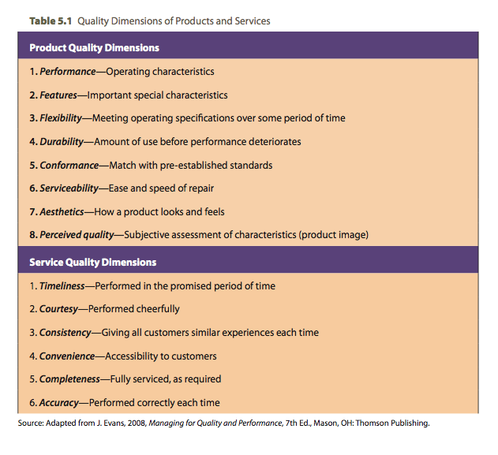
Quality Dimensions of Goods and Services

Slide 25
Factors Affecting Likelihood of Attack (cont’d)
First-Mover
Second Mover
Service quality dimensions include:
  timeliness
  courtesy
  consistency
  convenience
  completeness
  accuracy
Late Mover
Incentives
Organizational Size
Quality (Product)

Slide 26

Factors Affecting Likelihood of Response
Firms study three other factors to predict how a competitor is likely to respond to competitive actions:
  Type of competitive action
  Actor’s reputation
  Market dependence

Slide 27
Factors Affecting Strategic Response
Type of Competitive Action
Strategic actions receive strategic responses
  Strategic actions elicit fewer total competitive responses.
  The time needed to implement and assess a strategic action delays competitor’s responses.
Tactical responses are taken to counter the effects of tactical actions
  A competitor likely will respond quickly to a tactical actions.

Slide 28
Factors Affecting Strategic Response (cont’d)
Type of Competitive Action
An actor is the firm taking an action or response.
Reputation is the positive or negative attribute ascribed by one rival to another based on past competitive behavior.
The firm studies responses that a competitor has taken previously when attacked to predict likely responses.
Actor’s Reputation

Slide 29
Factors Affecting Strategic Response (cont’d)
Type of Competitive Action
Market dependence is the extent to which a firm’s revenues or profits are derived from a particular market.
Competitors with high market dependence are likely to respond strongly to attacks threatening their market position.
Actor’s Reputation
Market Dependence

Slide 30
Competitive Dynamics versus Rivalry
Competitive Dynamics
  Ongoing actions and responses taking place between all firms competing within a market for advantageous positions.
Competitive Rivalry
  Ongoing actions and responses taking place between an individual firm and its competitors for advantageous market position.

